Slide 1
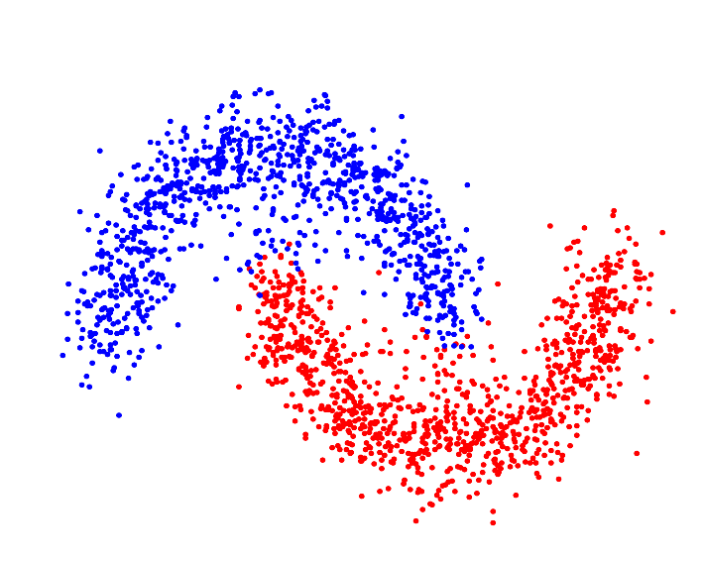

Intelligent Data Analysis
Clustering Evaluation
Prerequisites:
Hierarchical Clustering
Dendrograms
Link
-By
Rohan Sharma

Slide 2
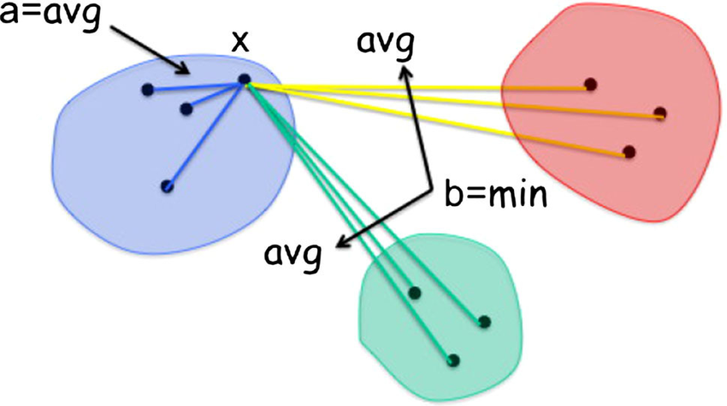

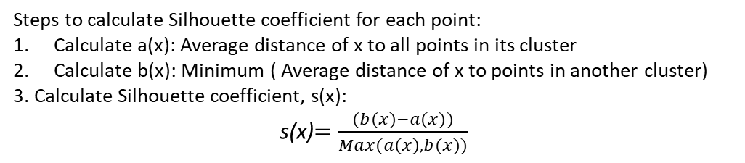
Clustering Evaluation | Silhouette coefficient : An Internal measure that integrates cohesion and separation
Steps to calculate Silhouette coefficient for each point:
Calculate a(x): Average distance of x to all points in its cluster
Calculate b(x): Minimum ( Average distance of x to points in another cluster)
3. Calculate Silhouette coefficient, s(x):
s(x)$=\frac{(b(x)−a(x))}{Max(a\left(x\right),b(x))}$
Range=: (-1,1)
Cluster A
Cluster C
-1
+1
Cluster B
Negative s(x):
This case refers to points that have a(x)>b(x);
inherently meaning poor cluster.
Worst values closer to -1
Positive s(x):
This case refers to points that have b(x)>a(x);
This is usually the case when there are closer points in the cluster compared to outside.
Best values closer to +1
Points to remember:
Silhouette coefficient is an unsupervised & internal measure
It is measured to evaluate clustering performance
It tries to integrate cohesion and separation
Calculated for each points
Best value : +1 Referring to case where a(x) is ~0 compared to b(x)
Worst Value: -1 Referring to case where b(x) is ~0 compared to a(x)

Slide 3
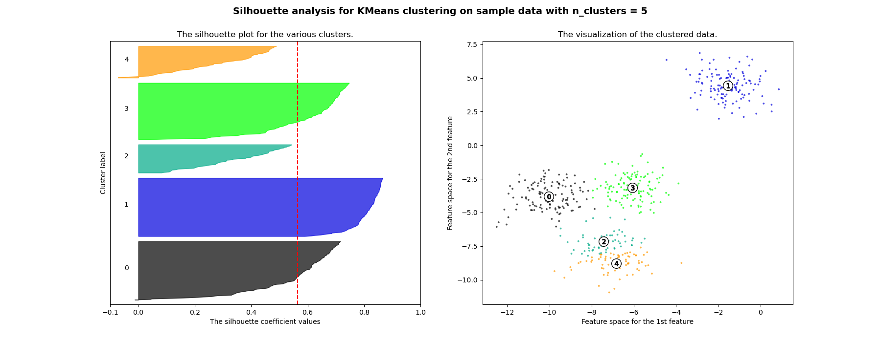
Clustering Evaluation | Silhouette Coefficient: Visualizing & Interpreting the chart
Points to remember:
The plot can be seen as a collection of horizontal lines ; each line corresponds to the silhouette coefficient for a point
The lines are grouped together by clusters, and sorted in descending order within each cluster

Slide 4
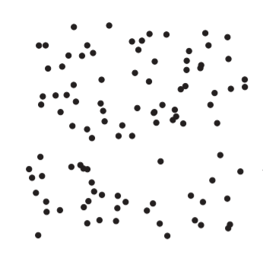
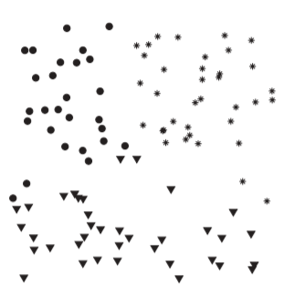
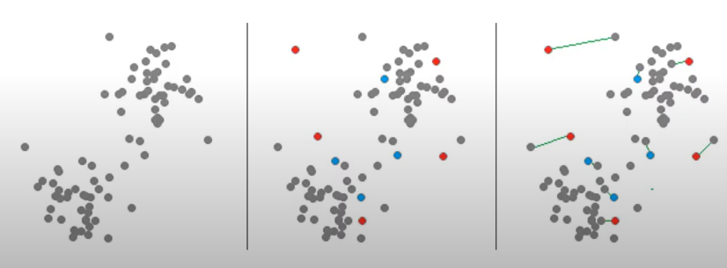
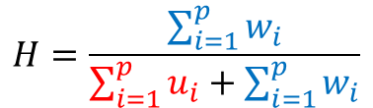
Clustering Evaluation | Hopkins Statistics : Are there clusters in the data?
Used for measuring the clustering tendency of data points
Why is it needed?
Clustering algorithms will create ‘best possible’ clusters in any data that we pass to them, even if there inherently no clusters.
Figure1:
100 uniformly distributed points
Figure2:
Clusters formed with K Means (n_cluster=3)
Steps to calculate:
1. Take ‘p’ points from the actual data set and generate ‘p’ points at random distributed across the data space.
2. Find nearest neighbor(NN) distances in the original dataset.
Let w_{i} be the NN distances of the sampled points from the data
Let u_{i} be the NN distances of the artificially generated points
3. Calculate Hopkins statistic H as:
$$H=\frac{\sum_{i=1}^{p}{w_{i}}}{\sum_{i=1}^{p}{u_{i}}+\sum_{i=1}^{p}{w_{i}}}$$
Figure3:
Grey: Original Points ; Blue: Points selected from the data ; Red: Artificially generated points
Points to remember:
Its important to measure the clustering tendency of data before clustering
Clustering algorithms can find clusters even in random noise
Hopkins's statistics is an effective measure to check the existence of clusters in the data
It compares the NN distances (from the original points) of sampled points and artificially generated points.

Slide 5
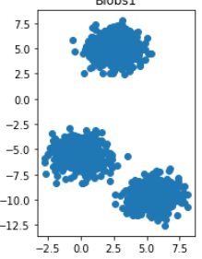

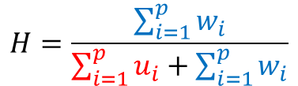

Clustering Evaluation | Hopkins Statistics: Interpreting Values
$$H=\frac{\sum_{i=1}^{p}{w_{i}}}{\sum_{i=1}^{p}{u_{i}}+\sum_{i=1}^{p}{w_{i}}}$$
{ Where w_{i} are NN dist. of the sampled points from the data
Where u_{i} are the NN dist. of the artificially generated points }
Range: (0,1)
0
0.5
1
0:
Presence of clusters in data
0.5:
High similarity with random data; No clusters
1:
Data is regularly distributed in the data space; no clusters
$$H=0.067$$
$$H=0.56$$
Figure 1:
Data with clusters
Figure 2:
Data with uniformly distributed points
Points to remember:
Best value of Hopkins statistic: ~0 : presence of clusters in the data
As NN distances of actual points are very small compared to that of randomly generated points

Slide 6

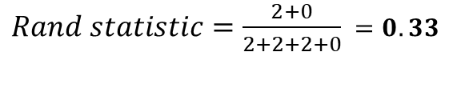
Clustering Evaluation | Rand Statistic : Supervised measure for cluster validity
Class Labels for data points are provided
The cluster validity is computed on the premise that 2 points belonging to same class should be present in the same cluster
Steps to compute:
Create the Ideal Cluster Similarity matrix (nXn)
ij^{th} entry is 1 if I & j belong to the same cluster, otherwise 0.
Create the Ideal Class Similarity matrix (nXn)
ij^{th} entry is 1 if I & j belong to the same class otherwise 0.
Compute Contingency table as:
Where,
f₀₀ = # of pairs of objects having a different class and a different cluster
f₀₁ = # of pairs of objects having a different class and the same cluster
f₁₀ = # of pairs of objects having the same class and a different cluster
f₁₁ = # of pairs of objects having the same class and the same cluster
Compute Rand index as:
Example:
Assume 4 points such that, two clusters:
C1 = {p1, p2} &
C2 = {p3, p4} , and two classes,
L1 = {p1, p3} &
L2 = {p2, p4}
 | Same Cluster | Different Cluster
Same Class | f11 | f10
Different Class | f01 | f00
Point | p1 | p2 | p3 | p4
p1 | 1 | 1 | 0 | 0
p2 | 1 | 1 | 0 | 0
p3 | 0 | 0 | 1 | 1
p4 | 0 | 0 | 1 | 1
Point | p1 | p2 | p3 | p4
p1 | 1 | 0 | 1 | 0
p2 | 0 | 1 | 0 | 1
p3 | 1 | 0 | 1 | 0
p4 | 0 | 1 | 0 | 1
Ideal Cluster Similarity Matrix
Ideal Class Similarity Matrix
 | Same Cluster | Different Cluster
Same Class | 0 | 2
Different Class | 2 | 2
Contingency Table
$Rand statistic=\frac{\text{f}\text{00}+\text{f}\text{11}}{\text{f}\text{00}+\text{f}\text{0}1+\text{f}\text{1}\text{0}+\text{f}\text{11}}$
$Rand statistic=\frac{2+0}{2+2+2+0}$ $=0.33$

Slide 7
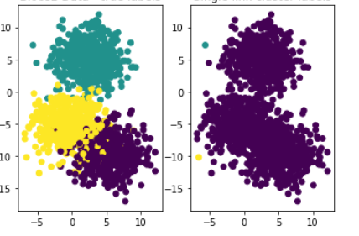
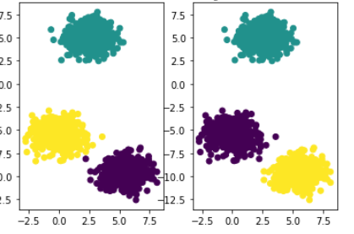
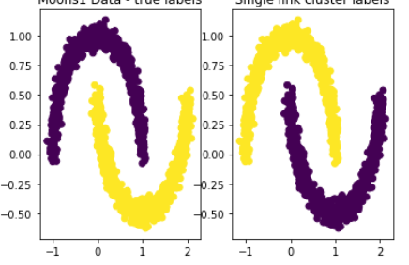

Clustering Evaluation | Rand Statistic : Interpreting Values
Range: (0,1)
 | Same Cluster | Different Cluster
Same Class | f11 | f10
Different Class | f01 | f00
0
1
$Rand statistic=\frac{\text{f}\text{00}+\text{f}\text{11}}{\text{f}\text{00}+\text{f}\text{0}1+\text{f}\text{1}\text{0}+\text{f}\text{11}}$
0:
Clusters and Labels do not agree on a any pair of points
1:
Clusters and Labels agree on all pairs of points
Q. A dataset after clustering has Rand statistic value of 1, what are the off-diagonal values of the contingency table between classes and clusters?
RI=0.33
Solution:
 | Same Cluster | Different Cluster
Same Class |  | 0
Different Class | 0
Q. A dataset with Rand statistic value of 1, has the following ideal class similarity matrix. What is the Ideal Cluster similarity matrix for the clustering?
RI=0.99
Point | p1 | p2 | p3 | p4
p1 | 1 | 0 | 1 | 0
p2 | 0 | 1 | 0 | 1
p3 | 1 | 0 | 1 | 0
p4 | 0 | 1 | 0 | 1
Solution:
Point | p1 | p2 | p3 | p4
p1 | 1 | 0 | 1 | 0
p2 | 0 | 1 | 0 | 1
p3 | 1 | 0 | 1 | 0
p4 | 0 | 1 | 0 | 1
If Rand statistic=1,
Ideal Cluster Similarity matrix
=
Ideal Cluster similarity matrix
RI=1

Slide 8
Clustering Evaluation | Cophenetic Correlation Coefficient: Evaluation for hierarchical clustering
The correlation between the pairwise original distance the Cophenetic Distance between data points
Cophenetic distance between two points is the distance between the clusters that the points belonged to at that stage of agglomerative clustering , where the two were selected to be combined
Distance | CDE | GI | H
AB | 0.5 | 0.8 | 0.9
A
B
C
D
E
G
I
H
0.5
Partial distance table (only for AB) at a stage in clustering
Cophenhetic Distance | A | B | C | D | E
A | 0 |  | 0.5 | 0.5 | 0.5
B |  | 0 | 0.5 | 0.5 | 0.5
Partial Cophenetic distance table (only for ABCD)
$\text{(}\text{CPCC}\text{) }\text{Cophenetic} \text{Correlation} \text{Coefficient}$ = Correlation(Cophenetic Distance, Distance)
Range: (-1,1)
-1
1
-1:
The clustering algorithm does not fit well for the data
1:
The clustering technique used fits well

Slide 9
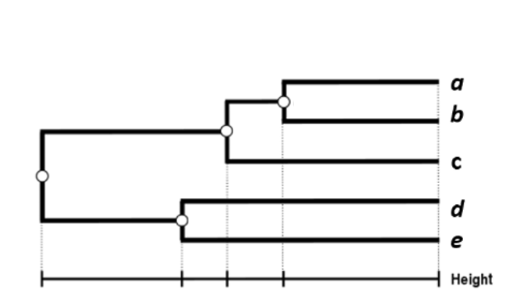
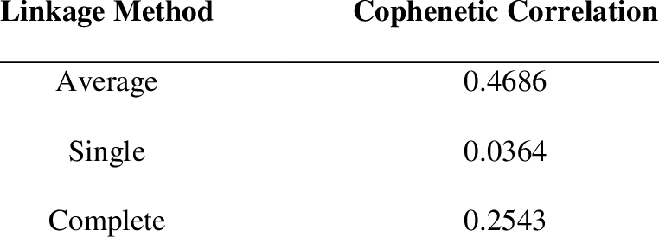


Clustering Evaluation | Cophenetic Correlation Distance & Coefficient: Examples
Toy example for computing Cophenetic distance matrix
Cophenetic Distance | a | b | c | d | e
a | 0 | 10 | 12 | 20 | 20
b |  | 0 | 12 | 20 | 20
c |  |  | 0 | 20 | 20
d |  |  |  | 0 | 15
e |  |  |  |  | 0
20
15
12
10
Sample Dendrogram
Sample Cophenetic distance matrix
Selecting the best agglomerative clustering using CPCC

Slide 10

Clustering Evaluation | Summarize : What we have learnt
Silhouette coefficient
How to Calculate for a data point?
Interpreting the chart & identifying which part in chart corresponds to which cluster in the geometric representation
What is the range? & Which value is better for clustering?
Hopkins Statistic
Why is it needed?
How is it calculated?
What is the range? & Which value is better for clustering?
Rand Score
Computing Ideal Cluster & Class similarity matrices
Filling the contingency table
How to calculate?
What is the range? & Which value is better for clustering?
Cophenetic Correlation Coefficient
What is it used for?
How to calculate?
What is the range? & Which value is better for clustering?
Thank You for your time!
For any feedback or question please reach out to me at sharmro@mail.uc.edu

